Slide 1
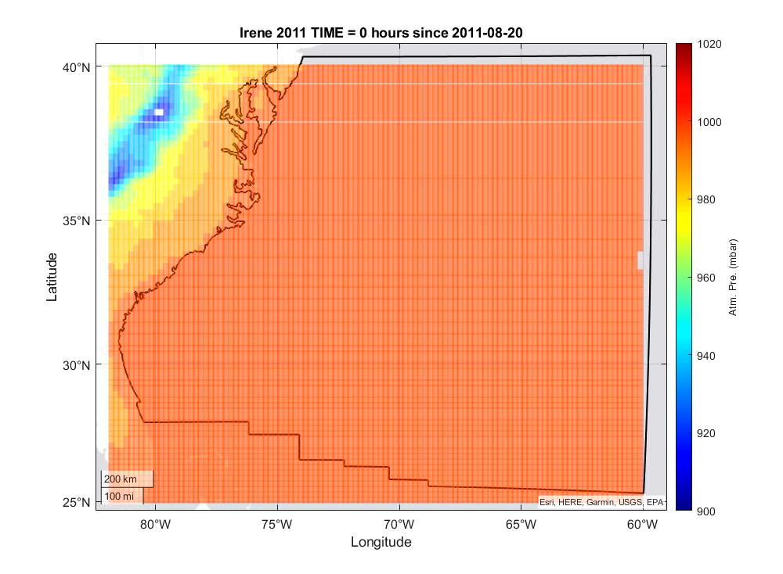
Pressure field of Hurricane Irene 2011

